Slide 1
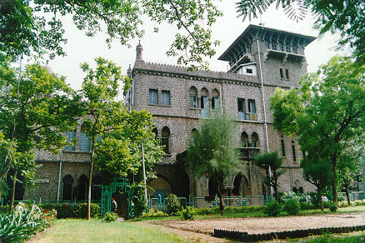

WELCOME TO COEP
Technological University
PLACEMENT CELL
COEP Technological University
A Unitary Public University of Govt. of Maharashtra
Formerly College of Engineering Pune

Slide 2
Placement Scenario for UG -- 2022-23
SN | Branch | UG
 |  | No.of Students |  | Placed
 |  | Admitted | Enrolled | No. of Students | %
1 | COMPUTER | 170 | 159 | 139 | 87.42
2 | E & TC | 100 | 92 | 79 | 85.87
3 | MECHANICAL | 165 | 157 | 124 | 78.98
4 | PRODUCTION | 75 | 67 | 41 | 61.19
5 | ELECTRICAL | 105 | 86 | 73 | 84.88
6 | INSTRUMENTATION | 43 | 40 | 34 | 85.00
7 | METALLURGY | 72 | 65 | 38 | 58.46
8 | CIVIL | 90 | 84 | 41 | 48.81
9 | PLANNING | 45 | 38 | 09 | 23.68
 |  | 865 | 788 | 578 | 73.35
AS On 12TH JULY 2023 |  |  | NO.OF COMPANIES VISITED - 198 NOS
COEP Technological University
A Unitary Public University of Govt. of Maharashtra
Formerly College of Engineering Pune

Slide 3
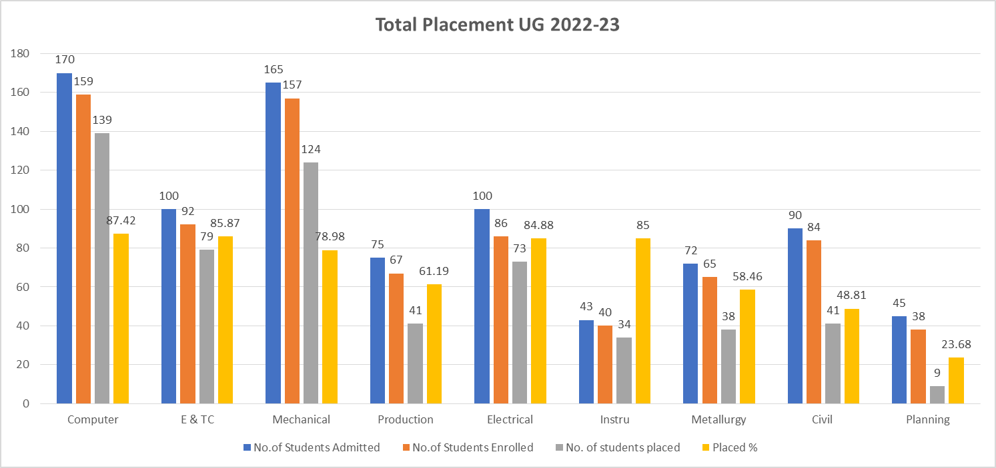

COEP Technological University
A Unitary Public University of Govt. of Maharashtra
Formerly College of Engineering Pune

Slide 4
Placement Scenario for PG --2022-23
SN | Branch | PG
 |  | No.of Students |  | Placed
 |  | Admitted | Enrolled | No. of Students | %
1 | COMPUTER | 34 | 20 | 11 | 55.00
2 | E & TC | 24 | 15 | 8 | 53.33
3 | MECHANICAL | 66 | 55 | 51 | 92.73
4 | PRODUCTION | 29 | 28 | 13 | 46.43
5 | ELECTRICAL | 43 | 36 | 22 | 61.11
6 | INSTRUMENTATION | 5 | 5 | 1 | 20.00
7 | METALLURGY | 1 | 1 | 0 | 0.00
8 | CIVIL | 86 | 72 | 25 | 34.72
9 | PLANNING | 31 | 18 | 0 | 0.00
 |  | 319 | 250 | 131 | 52.40
AS ON 12TH JULY 2023 |  |  | NO.OF COMPANIES VISITED - 198 NOS
COEP Technological University
A Unitary Public University of Govt. of Maharashtra
Formerly College of Engineering Pune

Slide 5
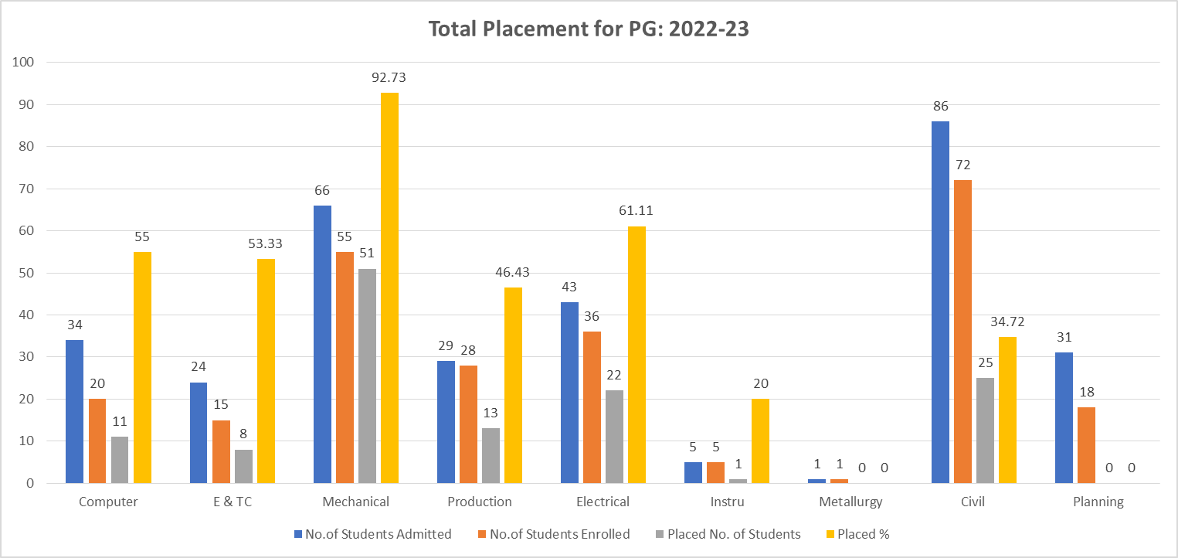
COEP Technological University
A Unitary Public University of Govt. of Maharashtra
Formerly College of Engineering Pune

Slide 6
SUMMER INTERNSHIP FOR T.Y.B.TECH STUDENTS -- 2022-23
SR.NO. | BRANCH | NO.OF STUDENTS PLACED
1 | COMPUTER | 134
2 | E & TC | 21
3 | INSTRUMENTATION | 16
4 | MECHANICAL | 128
5 | ELECTRICAL | 29
6 | PRODUCTION | 48
7 | METALLURGY | 15
8 | CIVIL | 34
9 | PLANNING | 26
 | TOTAL | 451
COEP Technological University
A Unitary Public University of Govt. of Maharashtra
Formerly College of Engineering Pune

Slide 7
Placement Scenario for the last 3 years (UG)
Details | 2020-21 | 2021-22 | 2022-23
Total Number of UG Students Enrolled | 710 | 729 | 788
Total Number of Students Employed | 491(69.15%) | 564 (77.37%) | 578 (73.35%)
No. of Companies Visited | 193 | 233 | 198
SALARY AMOUNT
HIGHEST SALARY | 37.00 LPA | 50.50 LPA | 50.50 LPA
AVERAGE SALARY | 8.30 LPA | 9.70 LPA | 11.35 LPA
MINIMUM SALARY | 3.00 LPA | 3.50 LPA | 4.00 LPA
COEP Technological University
A Unitary Public University of Govt. of Maharashtra
Formerly College of Engineering Pune

Slide 8
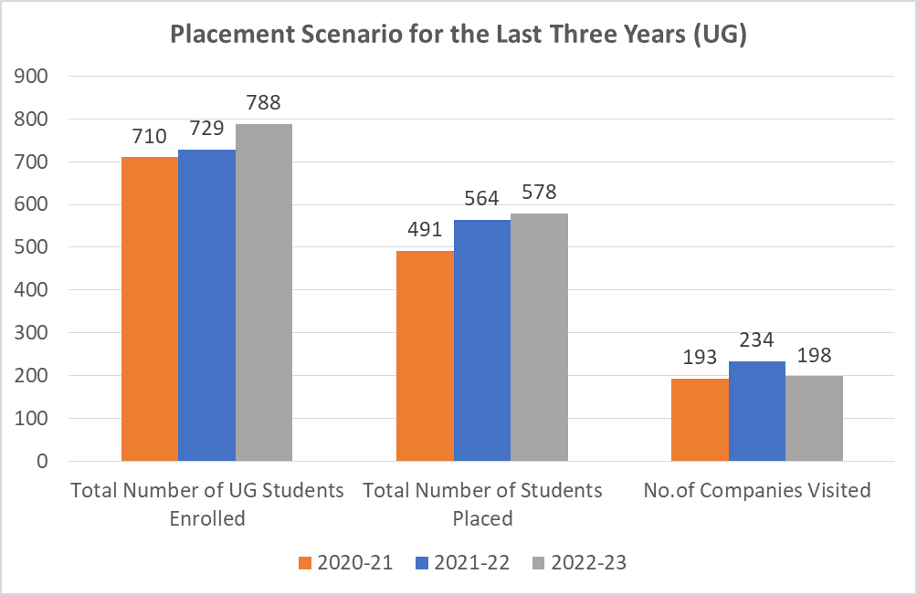
COEP Technological University
A Unitary Public University of Govt. of Maharashtra
Formerly College of Engineering Pune

Slide 9
Placement Scenario for the last 3 years (PG)
Details | 2020-21 | 2021-22 | 2022-23
Total Number of PG Students Enrolled | 376 | 410 | 250
Total Number of Students Employed | 180 (47.87%) | 307 (74.88%) | 131 (52.40%)
SALARY AMOUNT
HIGHEST SALARY | 24.85 LPA | 25.25 LPA | 37.49 LPA
AVERAGE SALARY | 6.26 LPA | 6.96 LPA | 7.82 LPA
MINIMUM SALARY | 3.00 LPA | 3.00 LPA | 4.00 LPA
COEP Technological University
A Unitary Public University of Govt. of Maharashtra
Formerly College of Engineering Pune

Slide 10

COEP Technological University
A Unitary Public University of Govt. of Maharashtra
Formerly College of Engineering Pune

